Slide 1






JOB SEARCH PORTAL WITH VOICE INTEGRATED CHATBOT
DOMAIN : CLOUD COMPUTING GUIDE : Mr . MODITYA
PG-2223-ETSD-682 | SHAIKH ALFRIDA
PG-2223-ETSD-775 | SHREYA ANUMUKONDA
PG-2223-ETSD-786 | SAGI LAKSHMI PASYANTHI
PG-2223-ETSD-841 | NAGA SAI SAMPATH NIMMALAPUDI

Slide 2

01
Abstract and Introduction
02
Literature Review And Problem Statement
CONTENTS
04
Services And Technologies Used
03
Problem Identification And Objectives
05
Implementation And Sample Outputs
06
Conclusion And References

Slide 3

ABSTRACT
Our primary motive is to build a job portal that will enable users to search for the latest jobs in one place instead of having to search and apply on various websites and social media. It will enable each user to create their own profile highlighting the talents and skills that they currently possess. Using this profile they can see jobs they are eligible for throughout the state, and can directly apply from the portal itself. The job portal will be designed in React JS in order to be in line with the latest technologies being used in the market today. Its features will be similar to those of cocubes or LinkedIn, but it will be even more efficient for use as it will provide a voice-based chatbot that can be accessed with a single word.

Slide 4




INTRODUCTION
JOB SEARCH PORTAL WITH VOICE INTEGRATED CHATBOT is a web application
That allows users to efficiently search for their desired jobs with ease. Similar to web portals such as LinkedIn and Internshala, this application will allow users to apply for jobs based on the domain, location, and required skillset. Users also have the benefit of knowing the status of their applications.
The voice integrated chatbot listens for user commands and is designed and trained in such a way that it guides the user to what they are looking for specifically. It is designed to reduce the effort and save the time of the user who is searching for a specific job or a job at a specific location.A user who wants only cloud-based jobs can ask the chatbot to return the results of companies hiring for that specific role. Similarly, a user who wants to stay in their hometown can ask the chatbot to only show jobs in that location.

Slide 5
LITERATURE REVIEW
The following are the current strategies for career searching:
Various job-search websites
Keyword-based searching in search engines
Email or any social media account may be used to promote your company.
Student services departments in schools, colleges, and universities.
All of these are time-consuming and confusing processes that take a lot of time and effort from the user’s end. Even though many jobs are available on the market, using the previously mentioned methods does not guarantee that the user will get the best results.

Slide 6

PROBLEM STATEMENT
There are also job portals such as Internshala and LinkedIn which are pre-existing web applications that also help users locate jobs of their choice. However, they do not have a responsive application that can tailor the results specifically to the user with just a word or two. There are also several management systems in existence but those are also not responsive.
Similar applications such as management systems are cloud-based. We have examined such systems in order to see how feasible our job search portal would be if it was deployed on the cloud. This manner prevents a majority of technical errors that can occur if we store the database and frontend in a local server. There is also a chance for errors in the EC2 instances but we have researched methods in order to prevent those bugs.

Slide 7
PREVIOUS MODELS
Websites like LinkedIn and Cocubes are in existence but they don’t have voice integration.
Cocubes is campus specific
LinkedIn is used for connections as well as profiles
This will be streamlined so it focuses on only locating and applying for jobs
It is an improvement to the existing models because it has an AI assistant that can make tasks easier and more time efficient

Slide 8
PROBLEM IDENTIFICATION AND OBJECTIVES
Providing Job Seekers a platform that will help them to get a job as per their skill set.
Providing Recruiters the best way to hire employees with a skillset as per the requirement of the organization.
Helps job seekers in such a way to keep the involved individuals informed about their status in the JOB SEARCH.
Help Recruiters to manage and update their profiles, and keep a track of all the Job Seekers who are applying to their companies.
Helps in referring a friend or someone who requires a job as per their domain and skillset.
Allow users to communicate with a responsive chatbot which will return results to them using only voice commands.

Slide 9
OBJECTIVE
To create a user friendly interface which makes the process of searching and applying for various job profiles an easy task. It is done with an interactive web-design which uses a voice activated chatbox so that users can communicate with ease.

Slide 10

SERVICES AND TECHNOLOGIES USED
EC2 instances of AWS to host the website’s frontend
React JS to design the front end for the various web pages
SSL Certificate to go from HTTP to HTTPS
Oauth which can be used to let users login with gmail or facebook
Chatbot which is designed using Artificial Intelligence and neural networks depending on the tasks it is given.
Voice Assistant to integrate with the chatbot

Slide 11
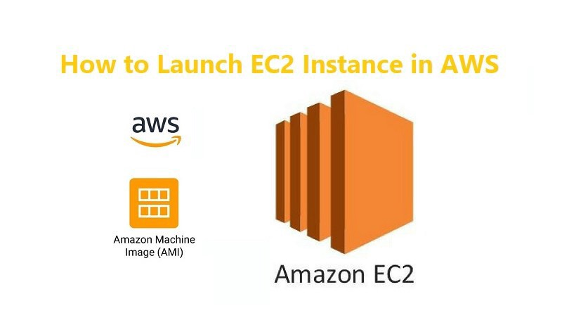
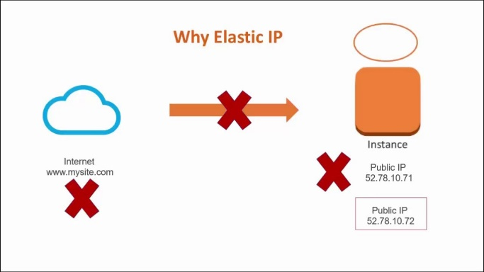
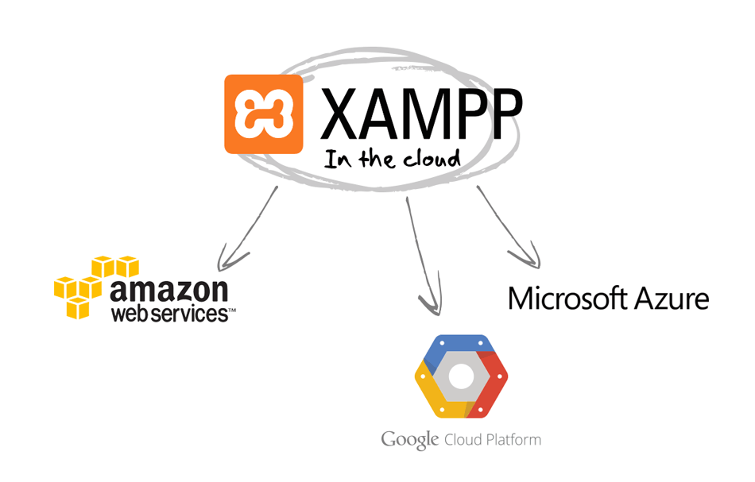

AMAZON WEB SERVICES- EC2 AND ELASTIC IP:
PUTTY SOFTWARE AND XAAMP SERVER:

Slide 12
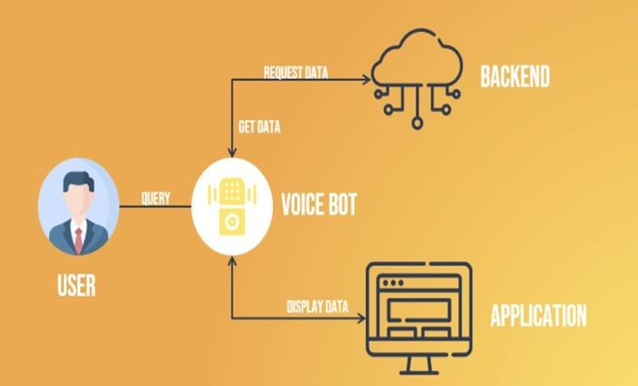
SYSTEM METHODOLOGY

Slide 13
First, the user needs to register or log in to the JOBSEARCH job portal.
Then the user gives a query based on the knowledge they require.
By reading and after receiving the query from the user the voicebot responds accordingly.
Voice bot responds in such a way that it requests data that the user requested from the backend.
After requesting the data from the backend it will get data from the backend that is been requested by the user.
It will then display the data to the user on the front end of the application which is visible to the user.

Slide 14
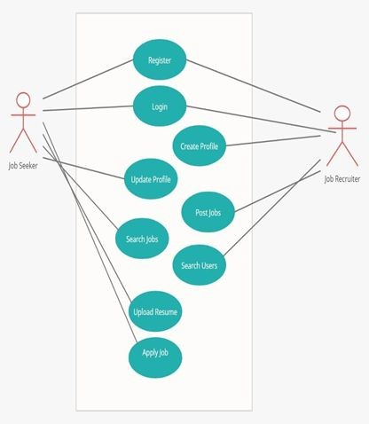
PROCESS DIAGRAM

Slide 15
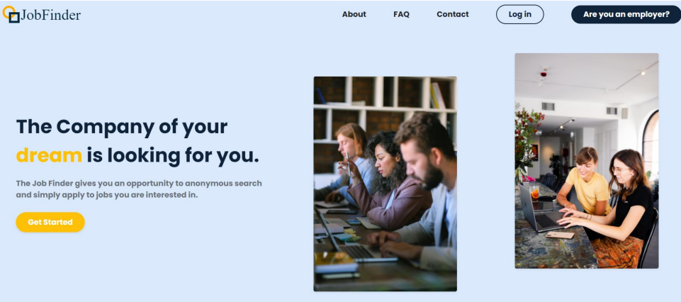
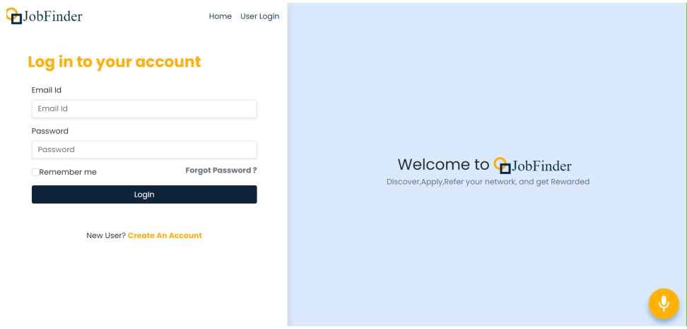
RESULT AND OUTPUTS
EMPLOYEE LOGIN :

Slide 16
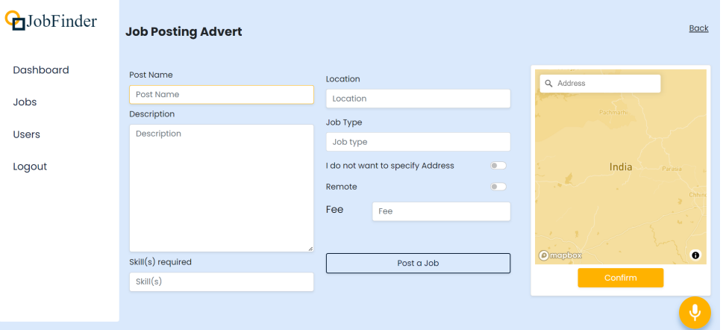
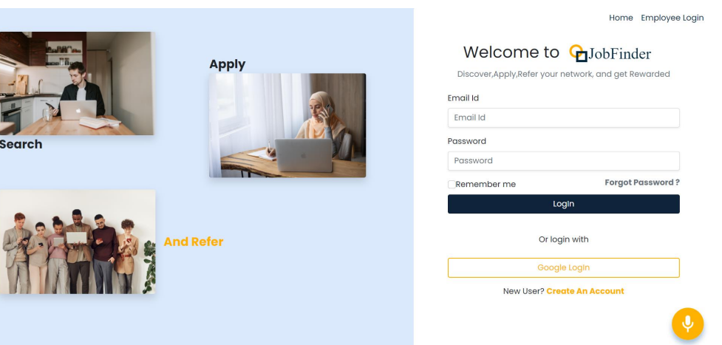
Posting A Job :
USER LOGIN :

Slide 17
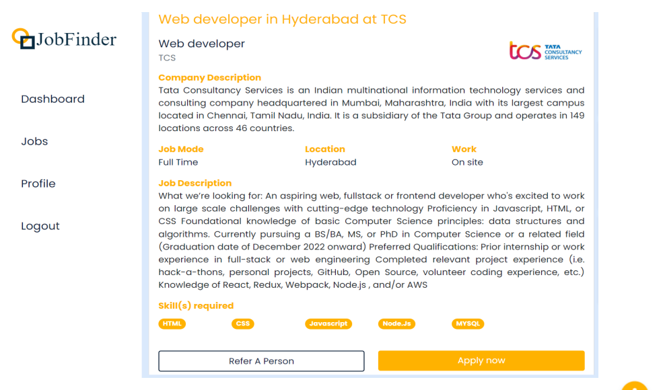
Applying For A Job :

Slide 18
CONCLUSION
Voice-enabled chatbots help us in providing better customer service and immediate assistance for daily tasks. Excluding this, you can also integrate it with various apps, channels or digital devices to help enhance your office productivity. Voice-bots let you operate hands-free. Your customer or even you could be typing out an email or having a meal and still be able to receive assistance from the digital assistant.
One thing about voice-bots, they can carry out a two-way conversation. Brands use voice-bots in their engagement and marketing strategies as this concept of talking to a robot is exciting and people are drawn towards it. It can create a positive sensation in people who interact with it. Adopting this technology makes way for a more integrated, pleasant and rich customer experience.

Slide 19




FUTURE SCOPE
In today's competitive environment, maintaining a solid customer relationship is critical for every business. The most difficult aspect of engaging clients just through SMS is that it takes time, and patience, and can get tedious after a while, resulting in customer apathy. Personalization, context, and emotions are frequently missing from plain texts. This also leads to a lot of dialogue misinterpretation.
In the future , since it is a competitive world, time is one major constraint that keeps us moving and industrialization is also growing , number of jobs increases and platforms are becoming more flooded , checking emails and keeping track of every job is difficult, hence this job portal would be of great use.

Slide 20
REFERENCES
Alourani, A., Kshemkalyani, A. D., and Grechanik, M. Alourani, A., Kshemkalyani, A. D., and Grechanik, M. (2020). T-BASIR: Detecting Cloud-Based Application Shutdown Bugs in Cloud Spot Markets. 31(8), 1912–1924, IEEE Transactions on Parallel and Distributed Systems. https://doi.org/10.1109/tpds.2020.2980265
A. R. Alzoubaidi (2016b). Private Cloud Computing Services for a Multi-Campus Interactive University 10(4), 37, International Journal of Interactive Mobile Technologies (IJIM). https://doi.org/10.3991/ijim.v10i4.5931
A data management solution for colleges and universities that is cloud-based (2016b). 5(5), 1968–1972, International Journal of Science and Research (IJSR). http://www.ijiet.org/papers/460-F017.pdf
GPS and Cloud Computing-based E-Blood Bank Application (2019). 3246–3249 in International Journal of Engineering and Advanced Technology, vol. 9, no. 2. https://doi.org/10.35940/ijeat.b2850.129219
5. Munir S, Jami SI (2020). Cloud computing trends. 2418-2435 in Indian Journal of Science and Technology 6. Shen, J., Zhou,
T., He, D., Zhang, Y., Sun, X., and Xiang, Y. Shen, J., Zhou, T., He, D., Zhang, Y., Sun, X., and Xiang,
Y. (2019).https://indjst.org/articles/current-trends-in-cloud-computing

Slide 21




Thank You

